Slide 1
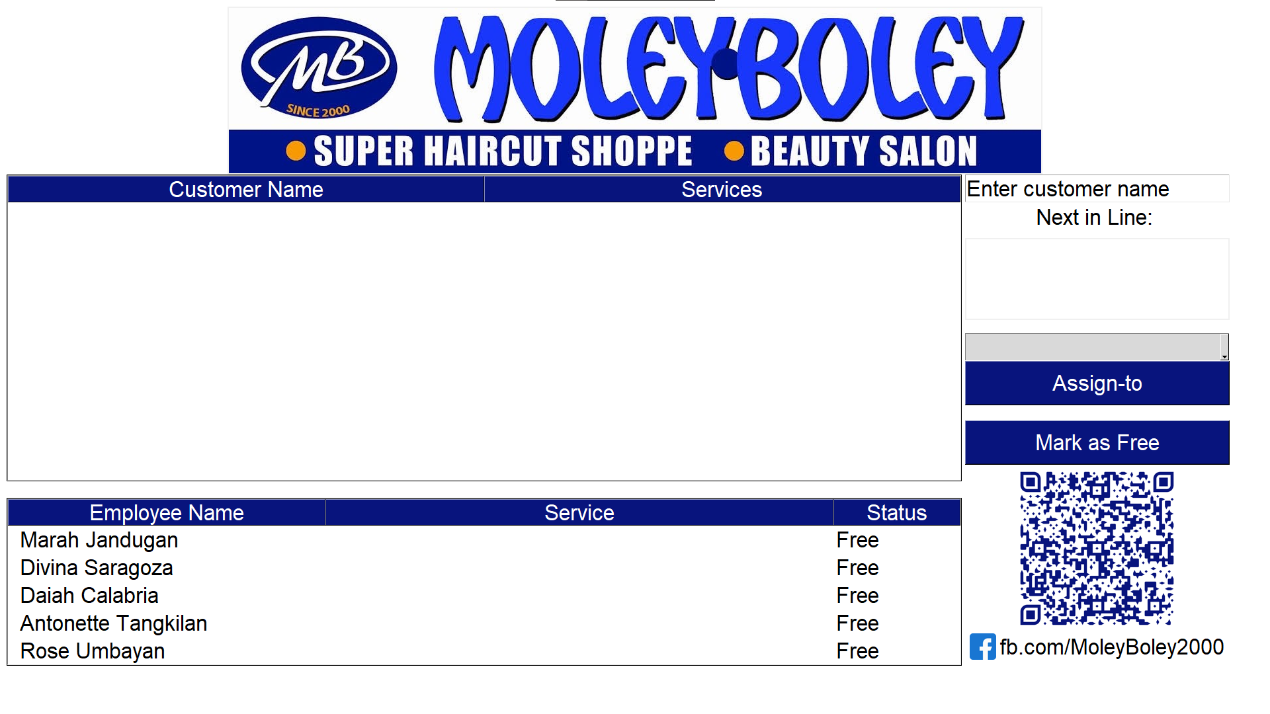

Slide 8

1
2

Slide 9
1
2
3

Slide 10


Slide 11
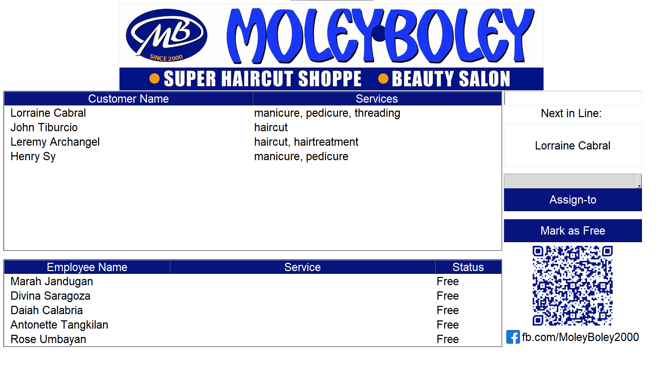

Slide 13
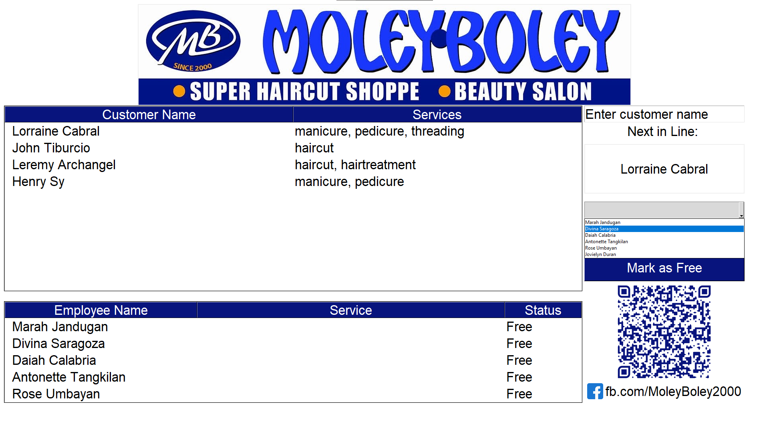

Slide 14
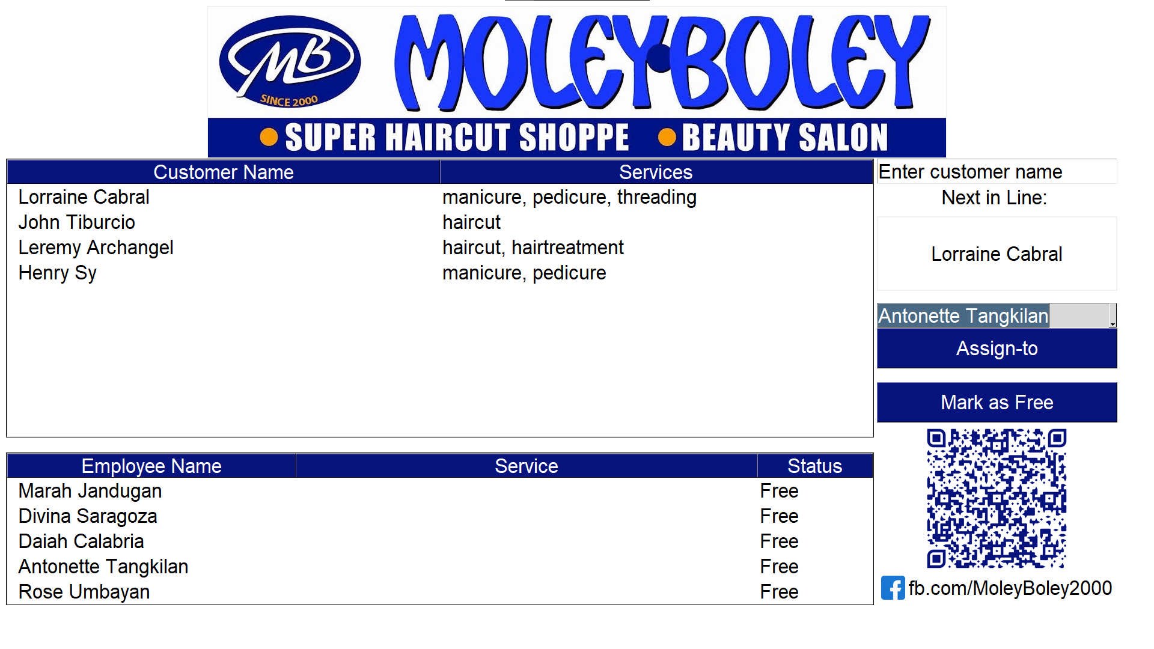

Slide 15
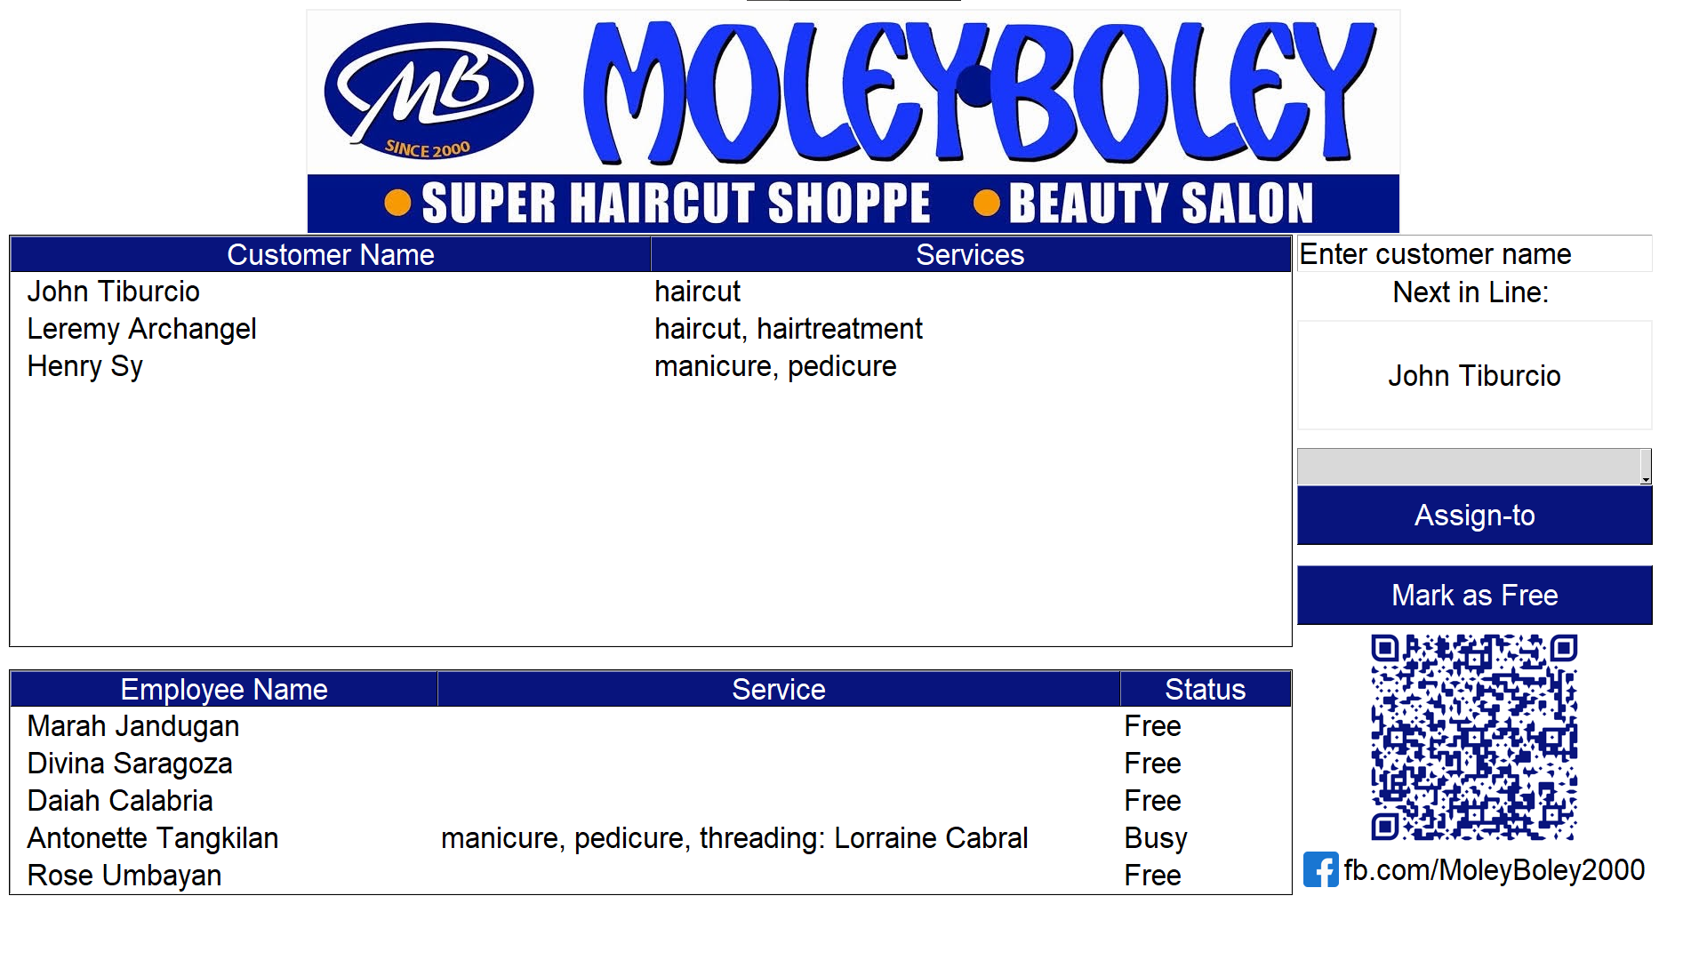
Customer was removed in Queue
Next in Line changed
She was added here, employee status changed too

Slide 16
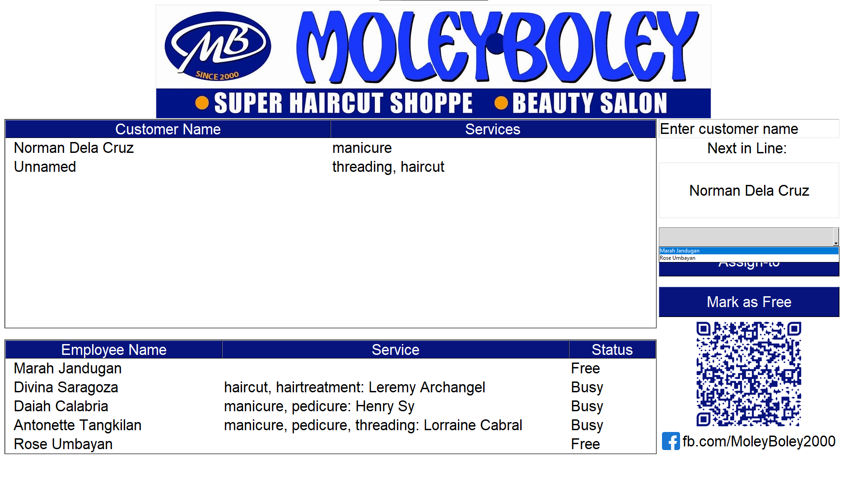
Only Free employees are shown
In the dropdown

Slide 17
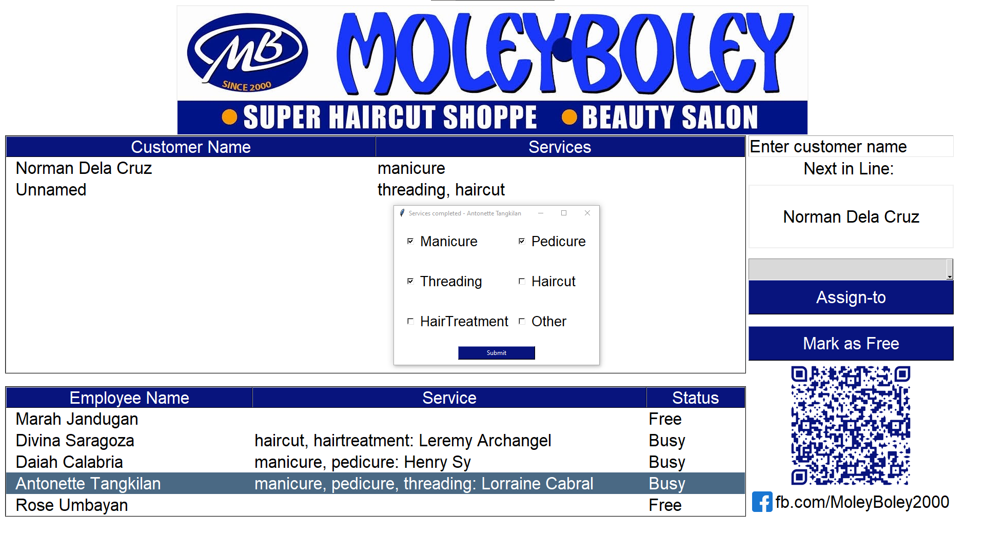
1

Slide 18
2
1

Slide 19
3
2
1

Slide 20
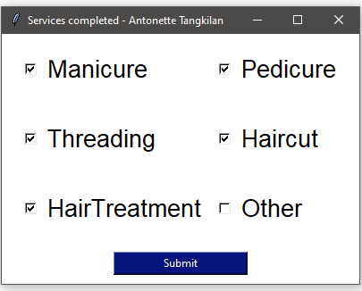

Slide 22
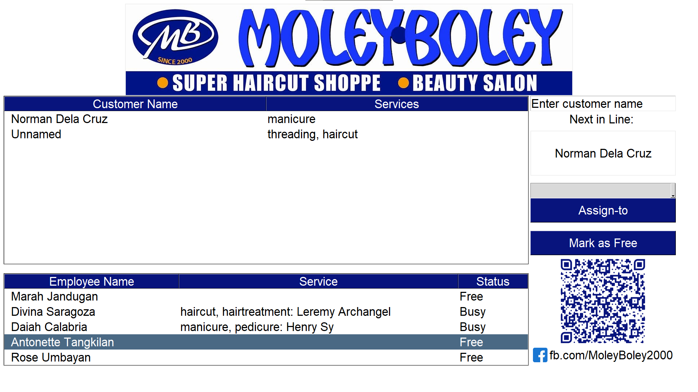

Slide 23
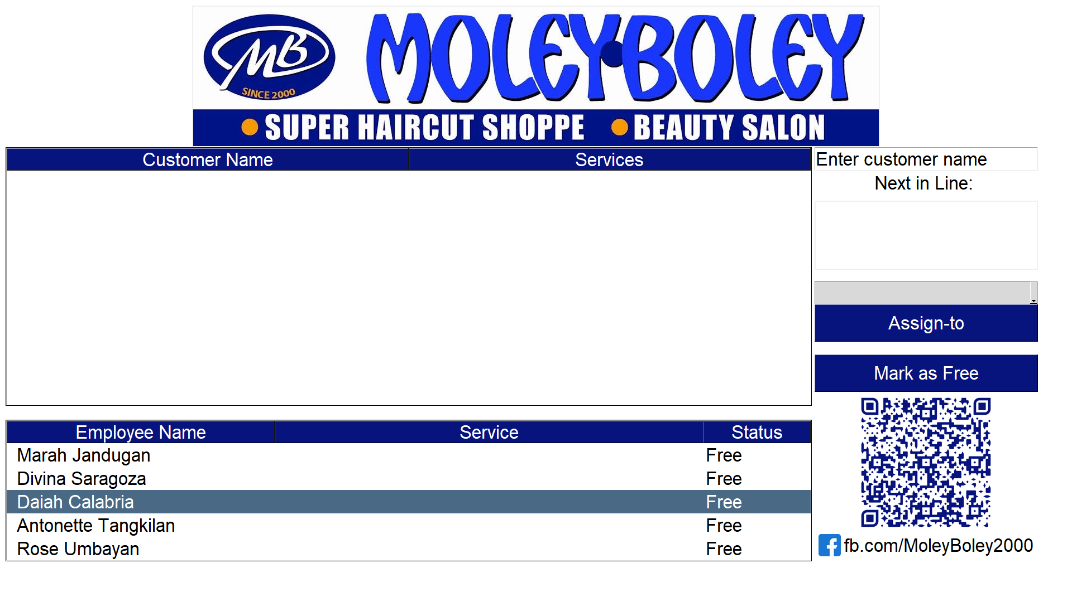

Slide 24
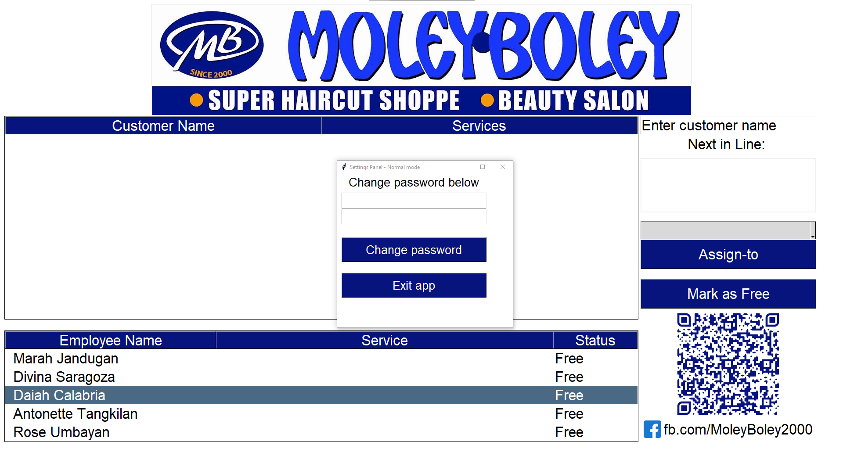
Type new password

Slide 26
Type new password

Slide 27
Click to change password

Slide 28
Click to Exit App

Slide 29
Admin

Slide 31
Double click anywhere here

Slide 32
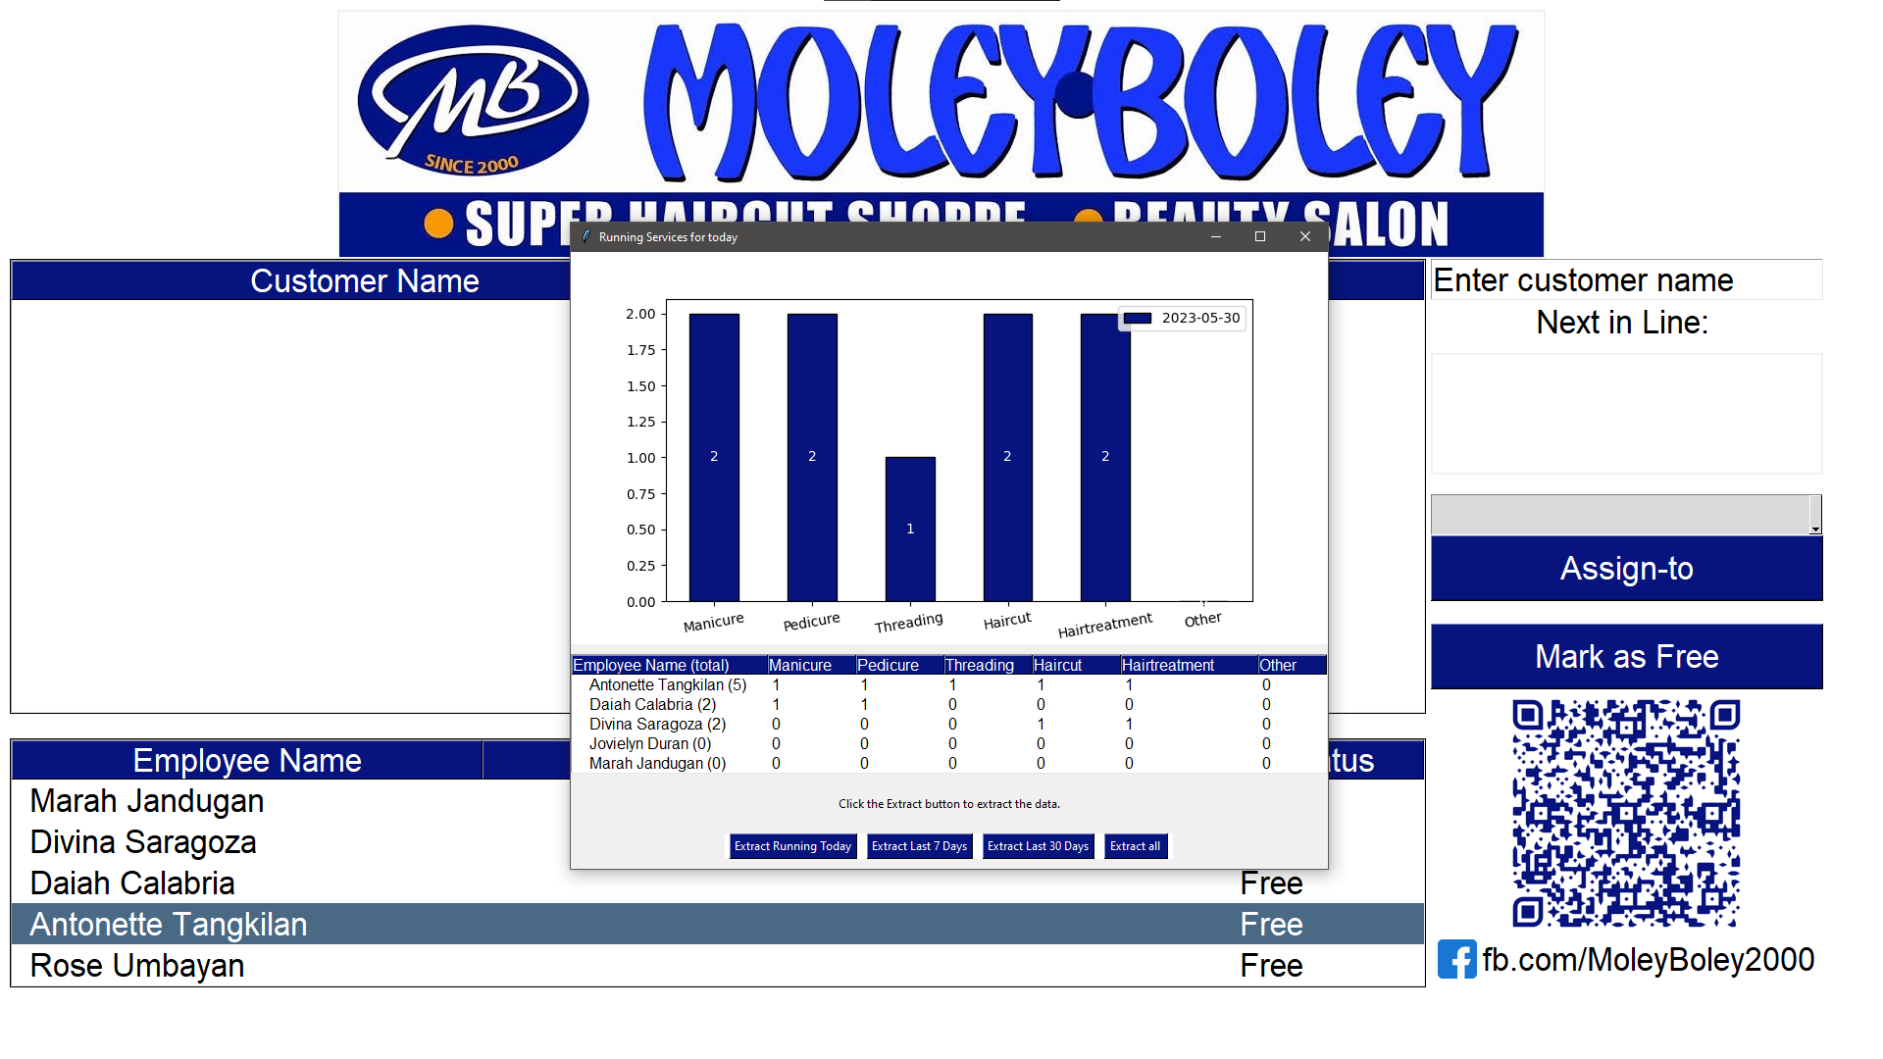
Today’s running sales

Slide 33
Today’s running sales

Slide 34
Today’s running sales

Slide 35
Customers served per
employee

Slide 36
Customers served per
employee

Slide 38
Customers served per
employee

Slide 39
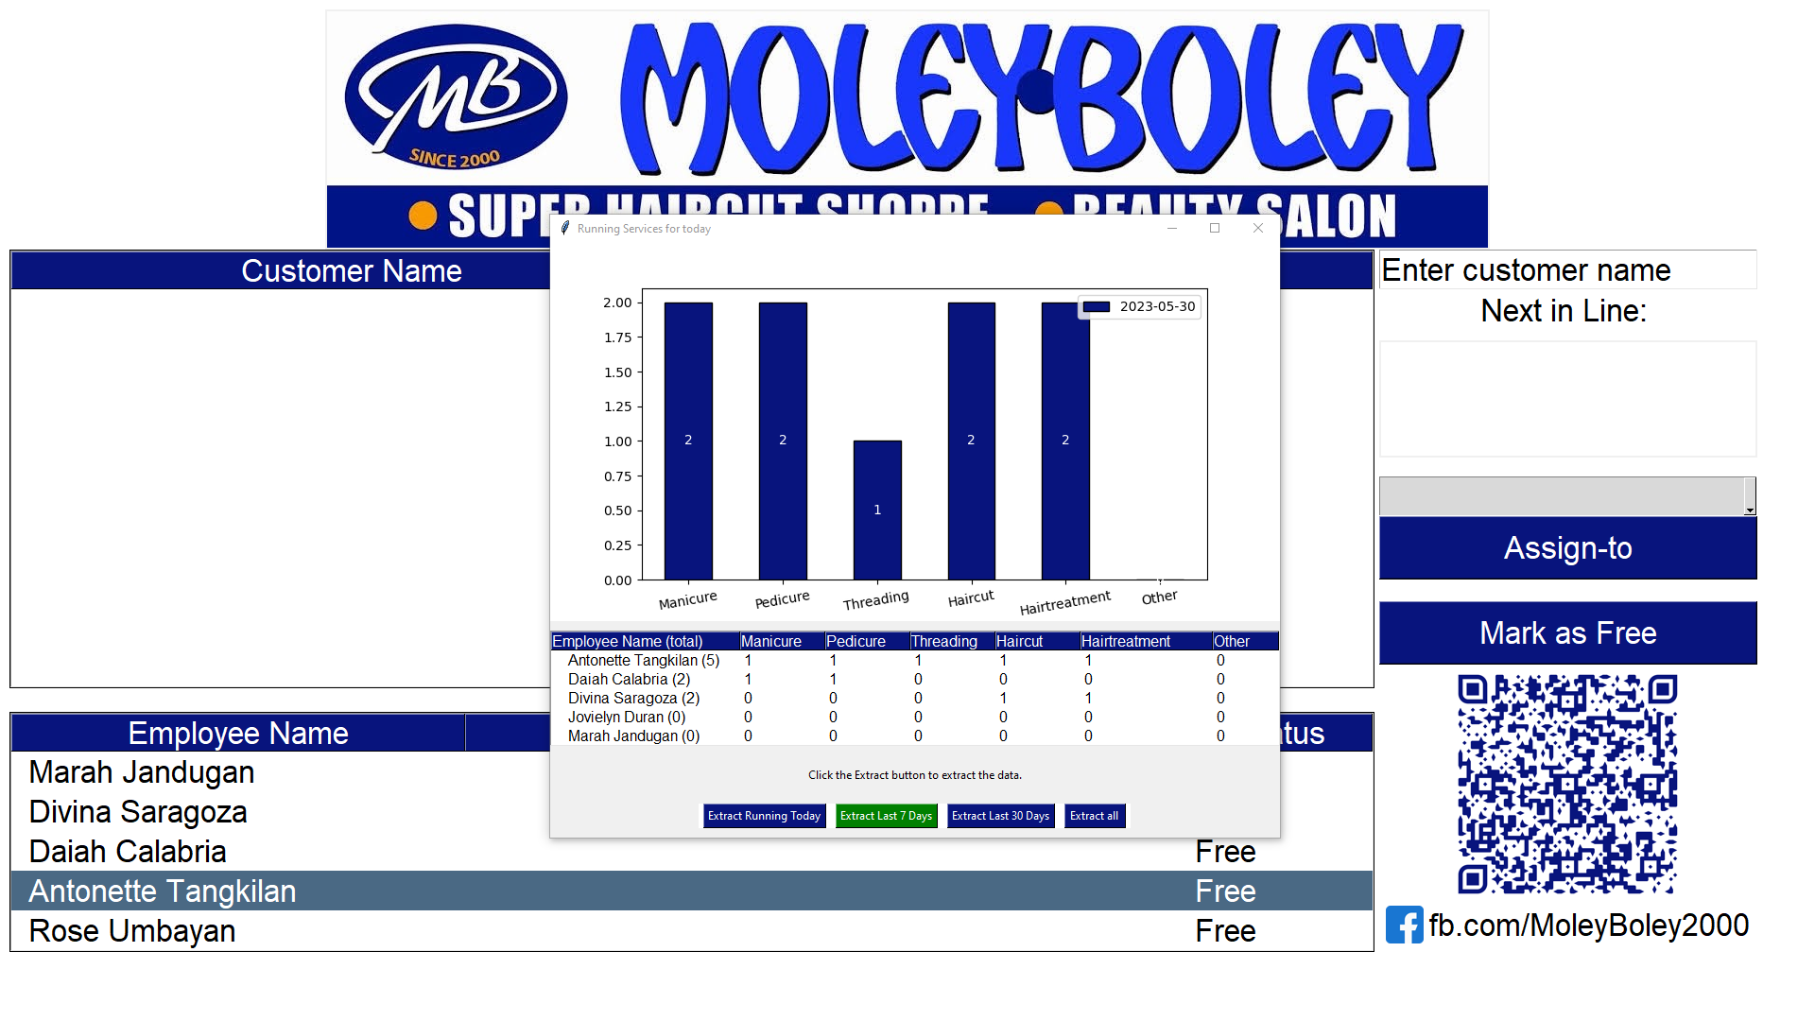

Slide 40


Slide 41
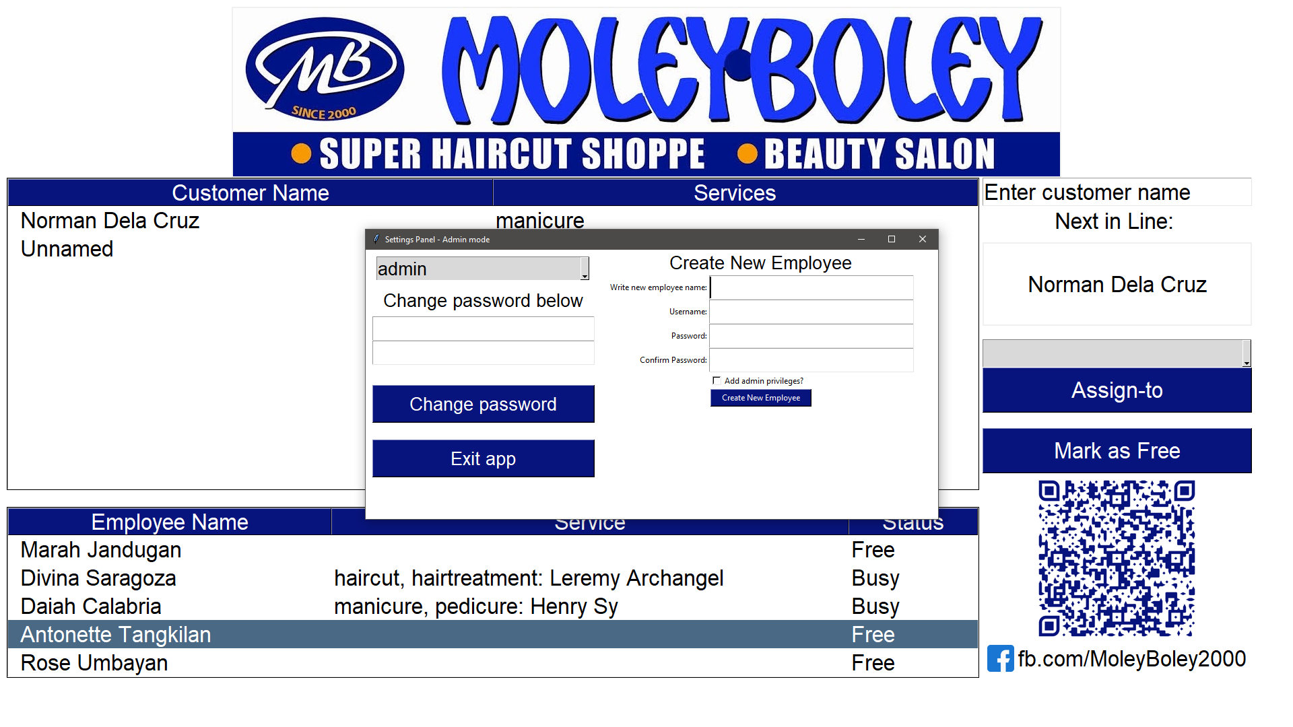

Slide 42
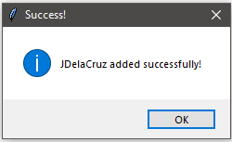

Slide 43
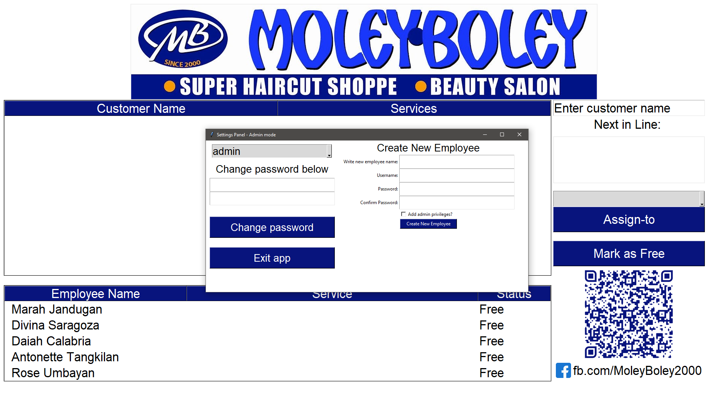

Slide 44
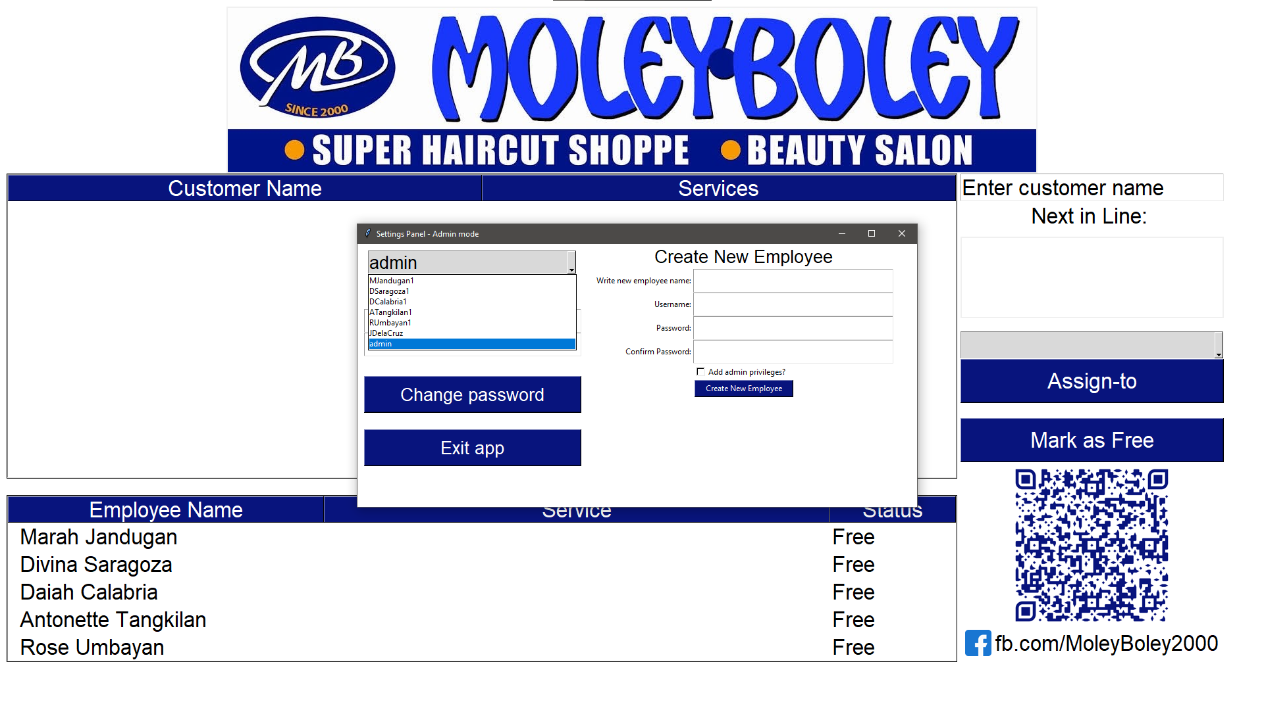

Slide 45
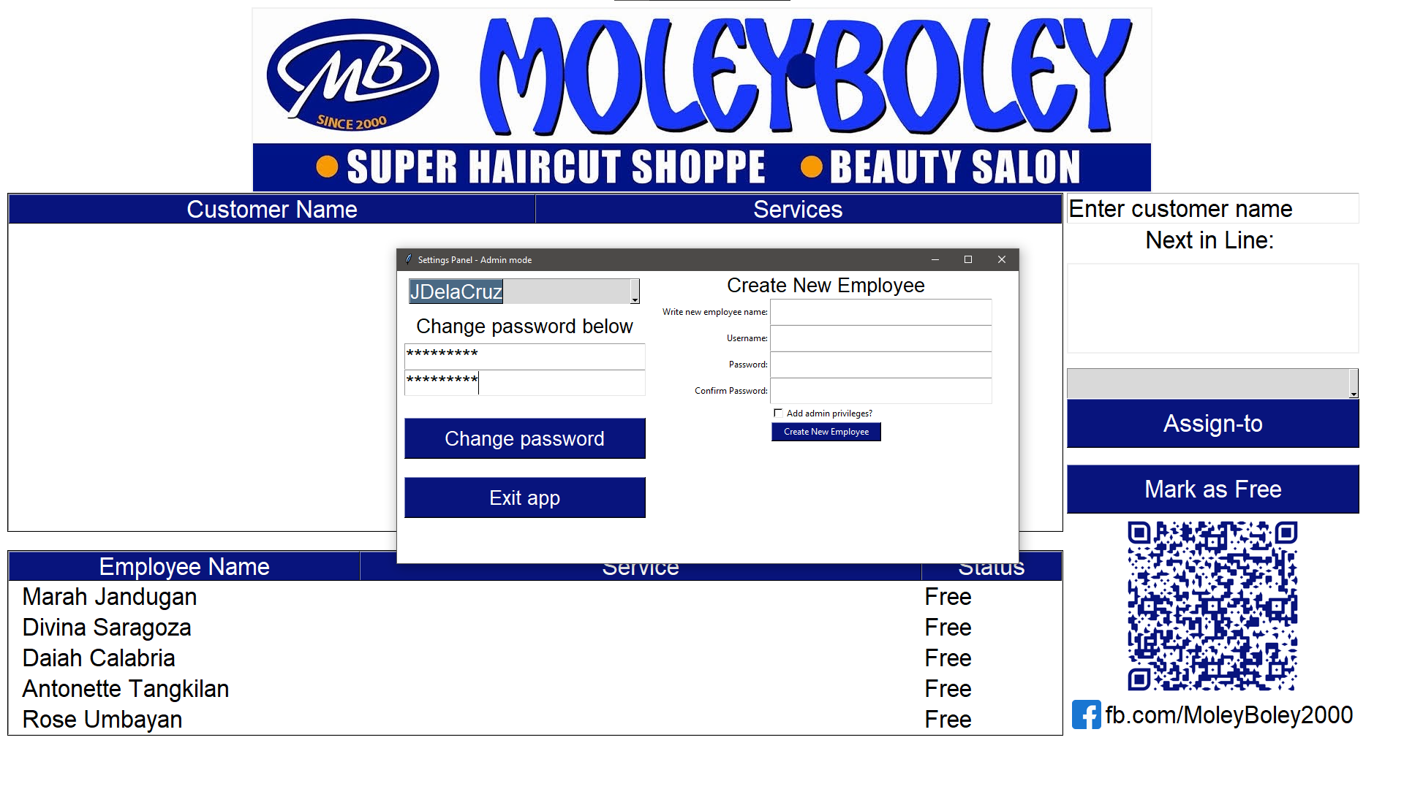

Slide 48
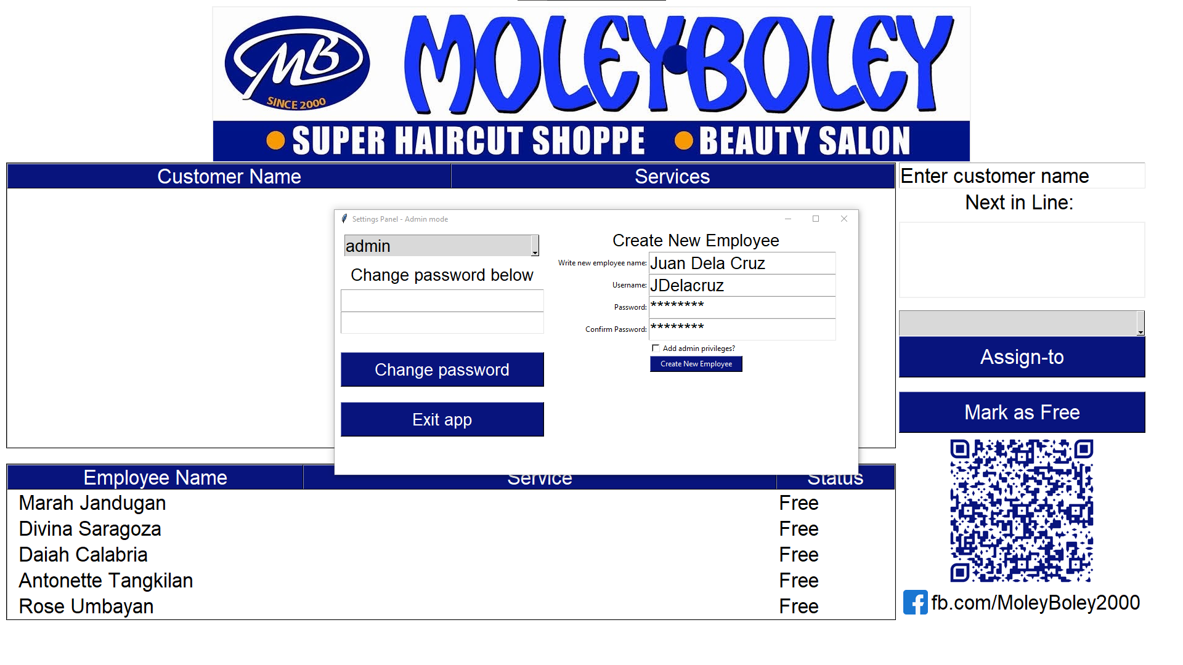

Slide 50
